Slide 1

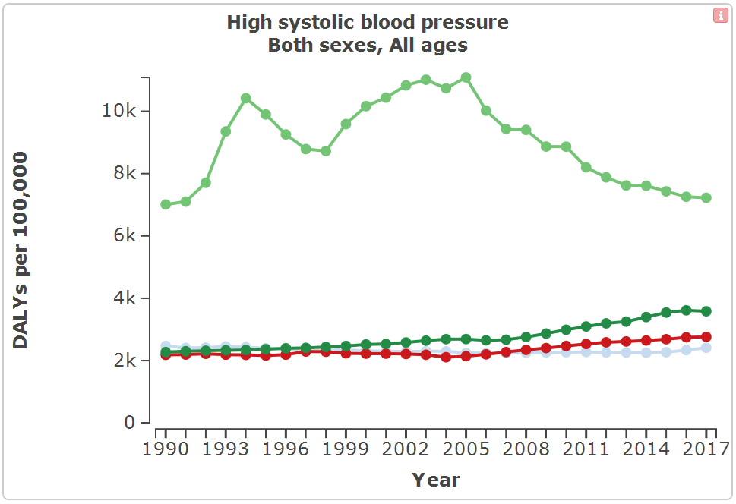
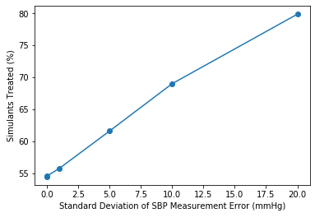
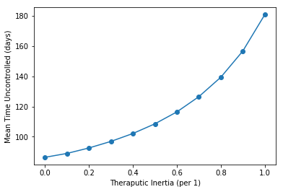
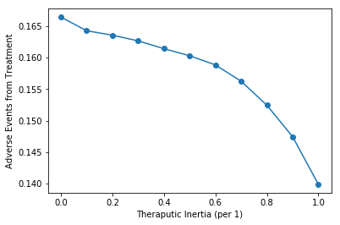
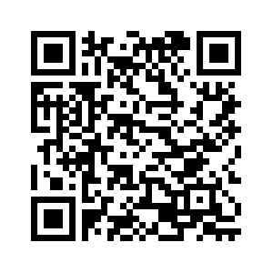
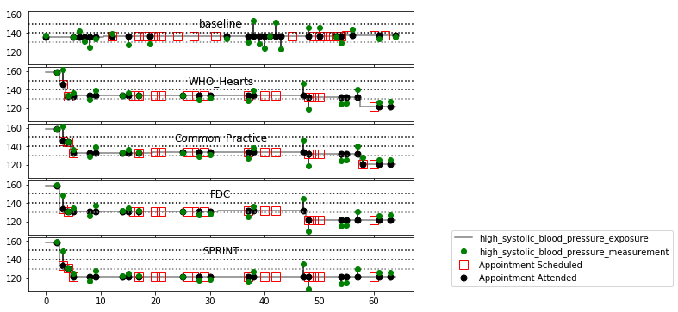
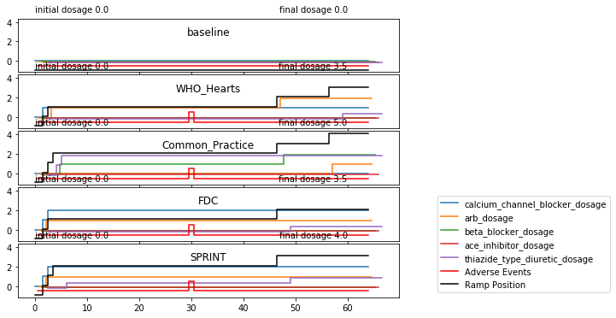
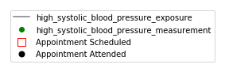
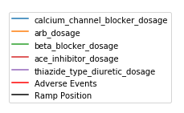
The impact of scaling-up screening and treatment for hypertension with fixed-dose combination therapy is large, and varies by country.
Non-Cognitive Predictors of Student Success: A Predictive Validity Comparison Between Domestic and International Students
Non-Cognitive Predictors of Student Success: A Predictive Validity Comparison Between Domestic and International Students
Health impact of hypertension control in four countries: an individual-based simulation model calibrated to Global Burden of Disease Study estimates
 | DALYs Averted (/100k PY) | SBP Shift (mmHG) | Change in % Controlled (pp) | Change in Time to Control (days)
Brazil | 991.0 | 7.4 | 17.8 | 55.2
India | 1524.2 | 6.2 | 14.2 | 44.7
China | 1604.7 | 6.3 | 14.3 | 40.8
Russia | 2963.8 | 8.2 | 18.4 | 58.0
Andrew Moran
Dorairaj Prabhakaran
Zixiao Li
Georges Saade
Paola Santalucia
Anthony Rodgers
Abraham D. Flaxman
Population Studied
1,000 replicates of cohorts of 1,000,000 adults representing the population aged ≥35 years in each of four middle-income countries.
Simulation Timeframe
2018 to 2023, with a 30 day step size
DALYs due to High SBP per 100k PY
INTRODUCTION
Globally, 218 million disability adjusted life years (DALYs) were lost due to systolic blood pressure (SBP) ≥140 mmHg in 2017.
The effectiveness of medications is established, but hypertension screening and medication coverage varies widely.
METHODS
We developed an individual-based model of hypertension risk, treatment, and related disease, calibrated to match GBD estimates at the population level.
Russia
We simulated an opportunistic screening program for hypertension using age-/sex-/location-specific outpatient visits as screening opportunities, couples with fixed-dose combination (FDC) therapy for individuals age 40+ with measured SBP ≥140 mmHg.
Table 1: The treatment strategy was based on 28-day follow-up visits for individuals who were above target (SBP 140 for age below 80, SBP 150 for age 80 and above); up-titration proceeded according to table:
China
India
Brazil
Impact of error in
SBP measurement
We compared population health under this intervention with the current standard of care.
Our model includes SBP measurement error, medication-related adverse events that lead to treatment discontinuation, and therapeutic inertia (the lack of intensified antihypertensive treatment for uncontrolled SBP).
We generated 1,000 replicates of 5 years of simulation for cohorts of 1,000,000 adults representing the population aged ≥35 years in each of four middle-income countries (Brazil, Russia, India, and China)
RESULTS
Difference in SBP between business-as-usual and FTC scenario varied from mean reduction of 6.2 mmHg in India to 8.2 mmHg in Russia, which corresponds to a change in the percent controlled of 14.2 percentage points (pp) in India to 18.4 pp in Russia. DALYs averted with FDC treatment varied from 990 per 100,000 person-years in Brazil to 3,000 in Russia.
Impact of Therapeutic Inertial (delay in increasing
treatment intensity when recommended by guidelines)
Patient profile in multiple alternative scenarios
Notes:
Interactive version of DALYs due to Hypertension plot: http://ihmeuw.org/4sna

